Slide 1
Advance Android
By-
Shubham Sahu
ILP Innovations

Slide 2
Content
Introduction to Android
Android for TV
Android for Wearable
Android for Car (Android Auto)
Google Cloud Messaging
Case Studies
Chat Bot (AI in Android)
Chat message (Broadcast Receiver)
Geo fence (Location)
Use case (3rd party libraries)
TCS Internal

Slide 3

Introduction to ILP & terminologies
ILP- Initial Learning Program
ILP Centers
  Trivandrum
  Chennai
  Ahmedabad
  Guwahati
  Hyderabad
LG- Learner Group
Schedule
Emergency contacts

Slide 4
What is MyILP
Focuses mainly on schedule for LGs and emergency contacts for ILP centers
Other features
  TCS Safety first
  Locations
  Quiz
  Feedback
  Notifications
  AR showcase
Chatbot
Ubiquitous computing:
Android, Wear, TV, IOS, Windows

Slide 5

Splash screen
Referred to as “Boot screen” or “Welcome screen”
Android apps do take some amount of time to start up, especially on a cold start
Splash screen can be used to utilize start up time to do some background tasks
My ILP uses splash screen to do background tasks, such as loading schedules from network, checking internet connection, prompting for permissions

Slide 6
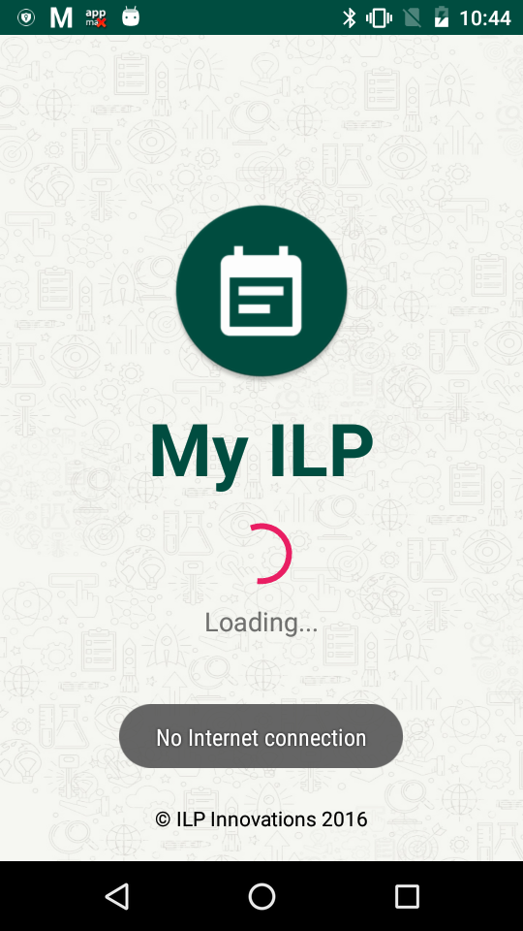
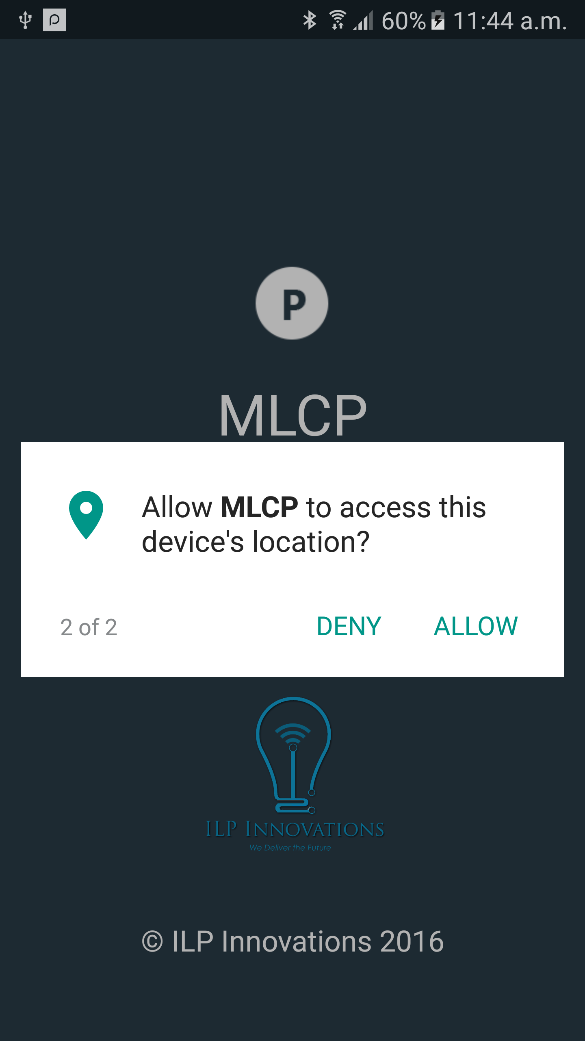
Splash Screen

Slide 7
Home Screen
Displays schedule based on the LG name provided
Schedule for specific date can be queried
Displays emergency contacts based on location selected in drop-down
UI toggle
Database hosted at “TheInspirer.in”

Slide 8
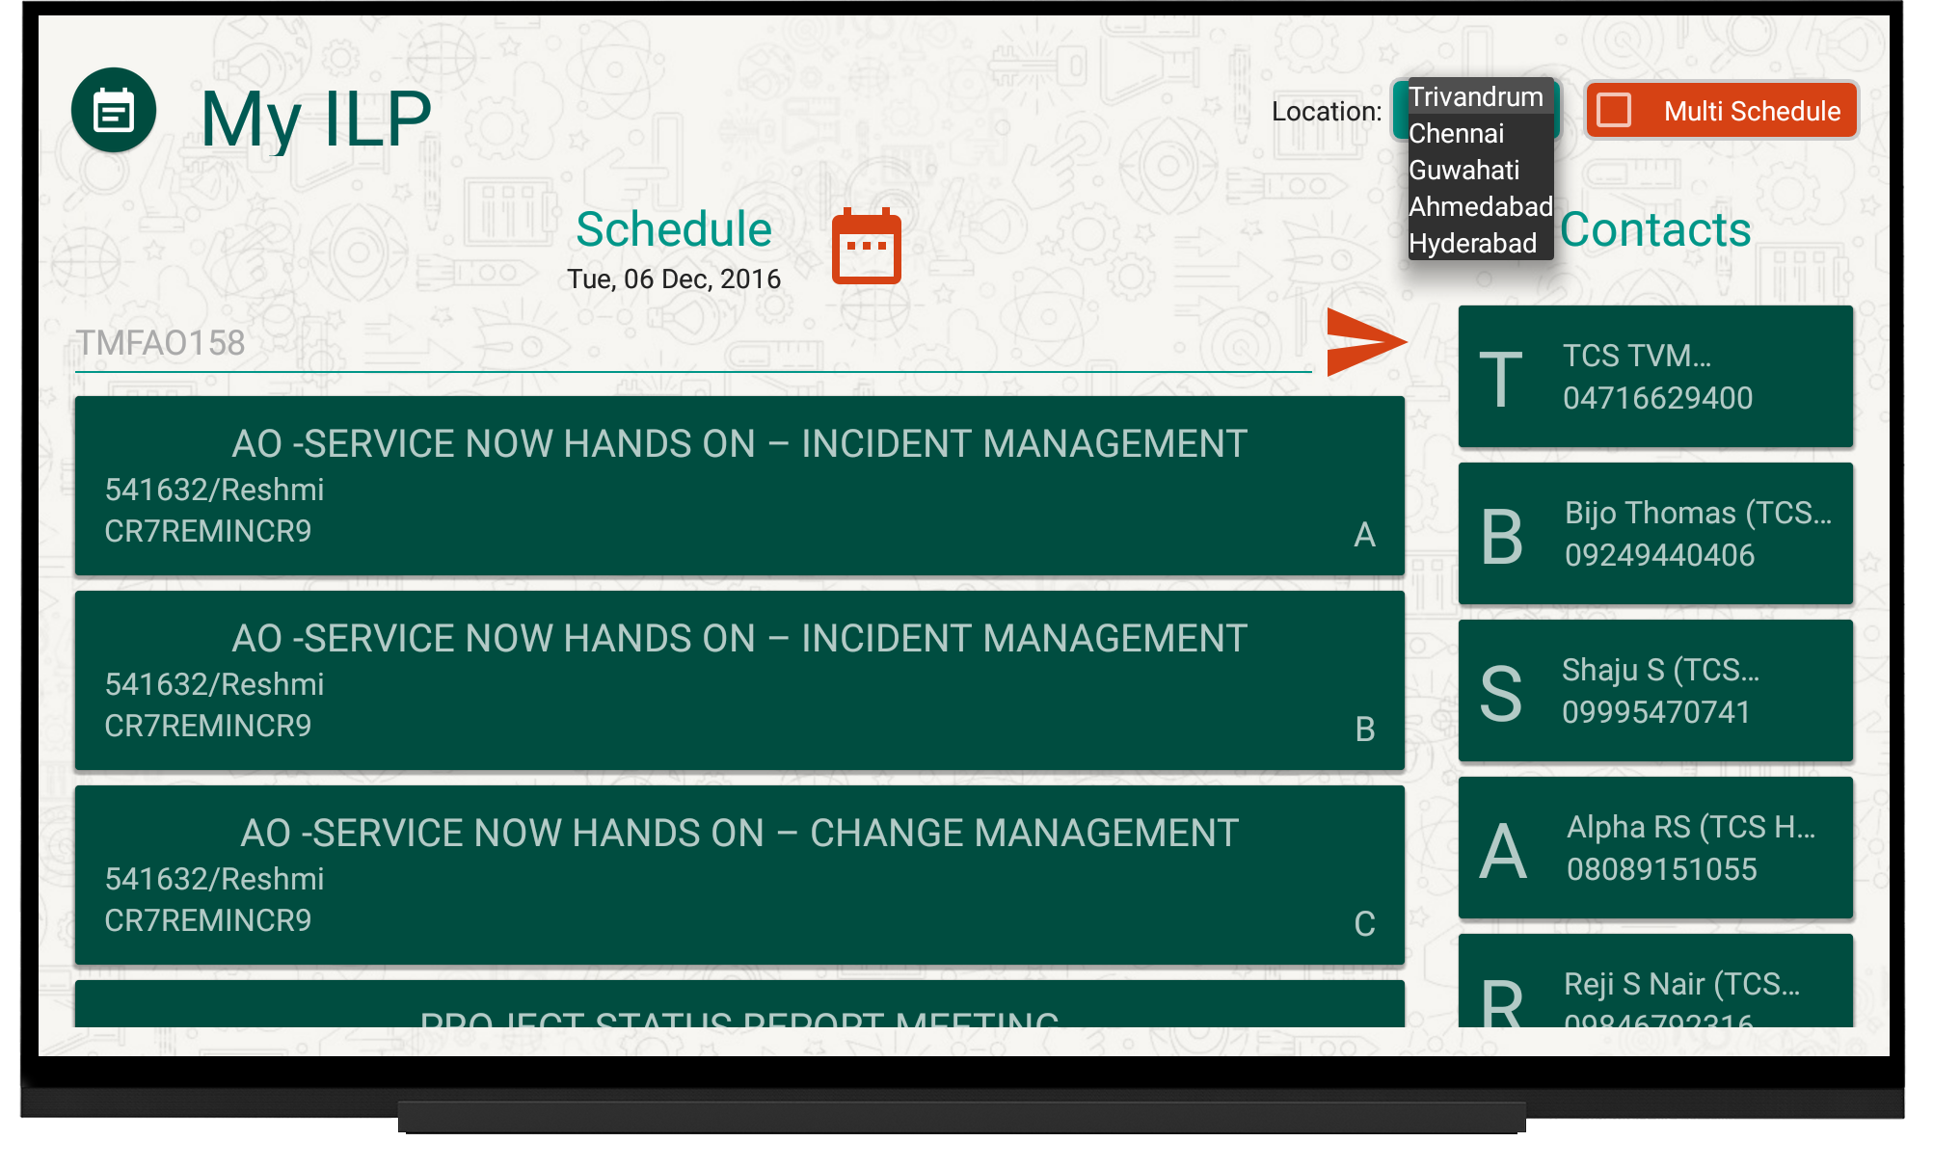
Home Screen

Slide 9
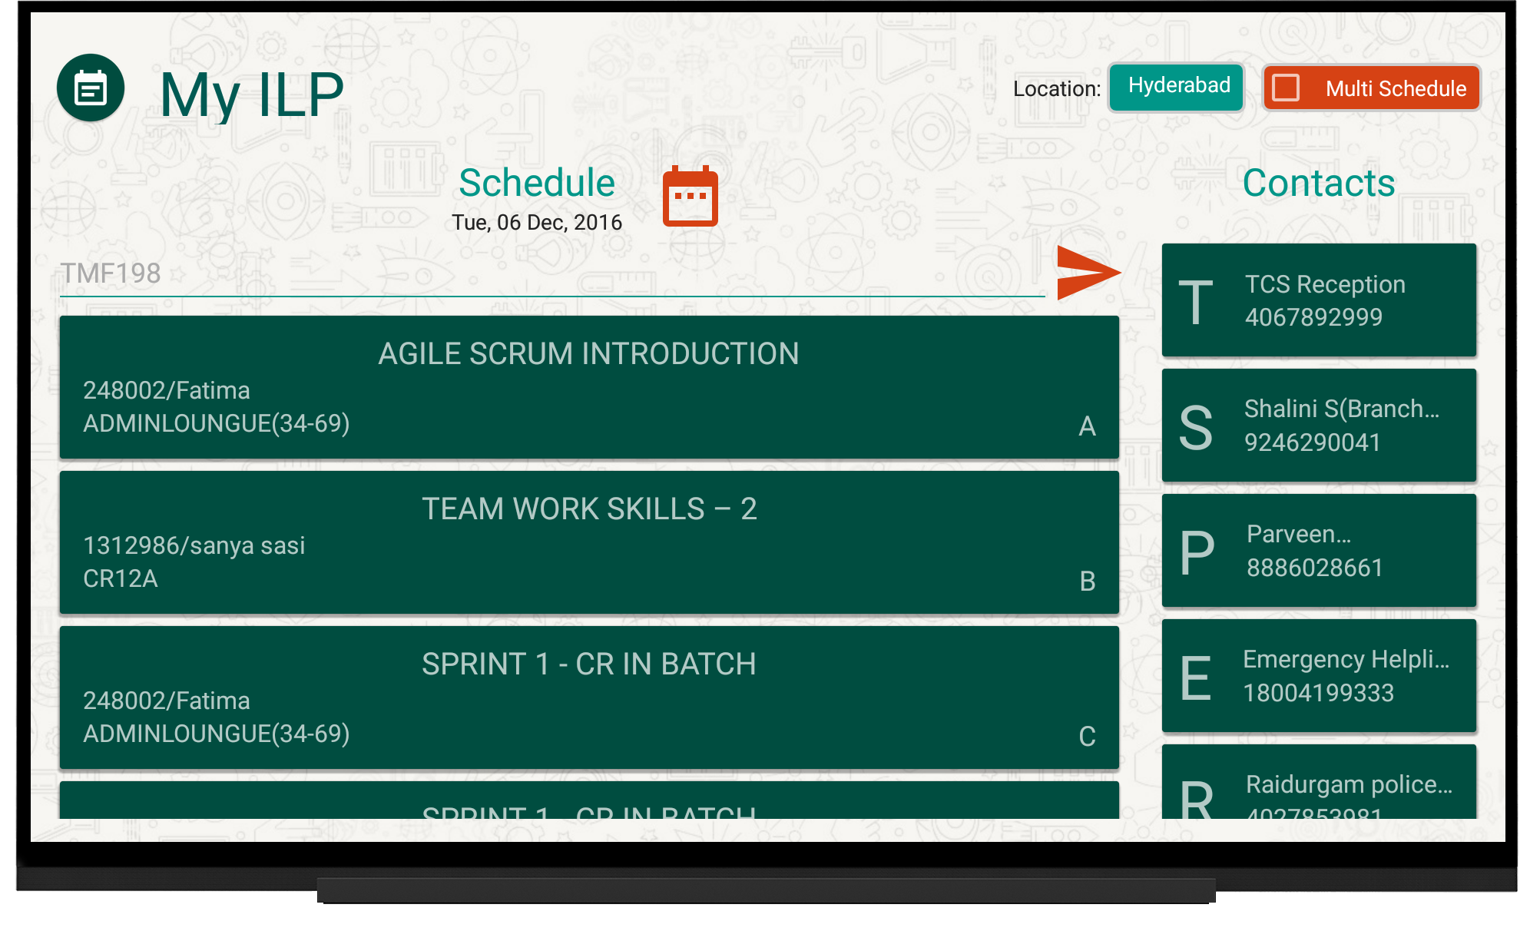
Home Screen

Slide 10
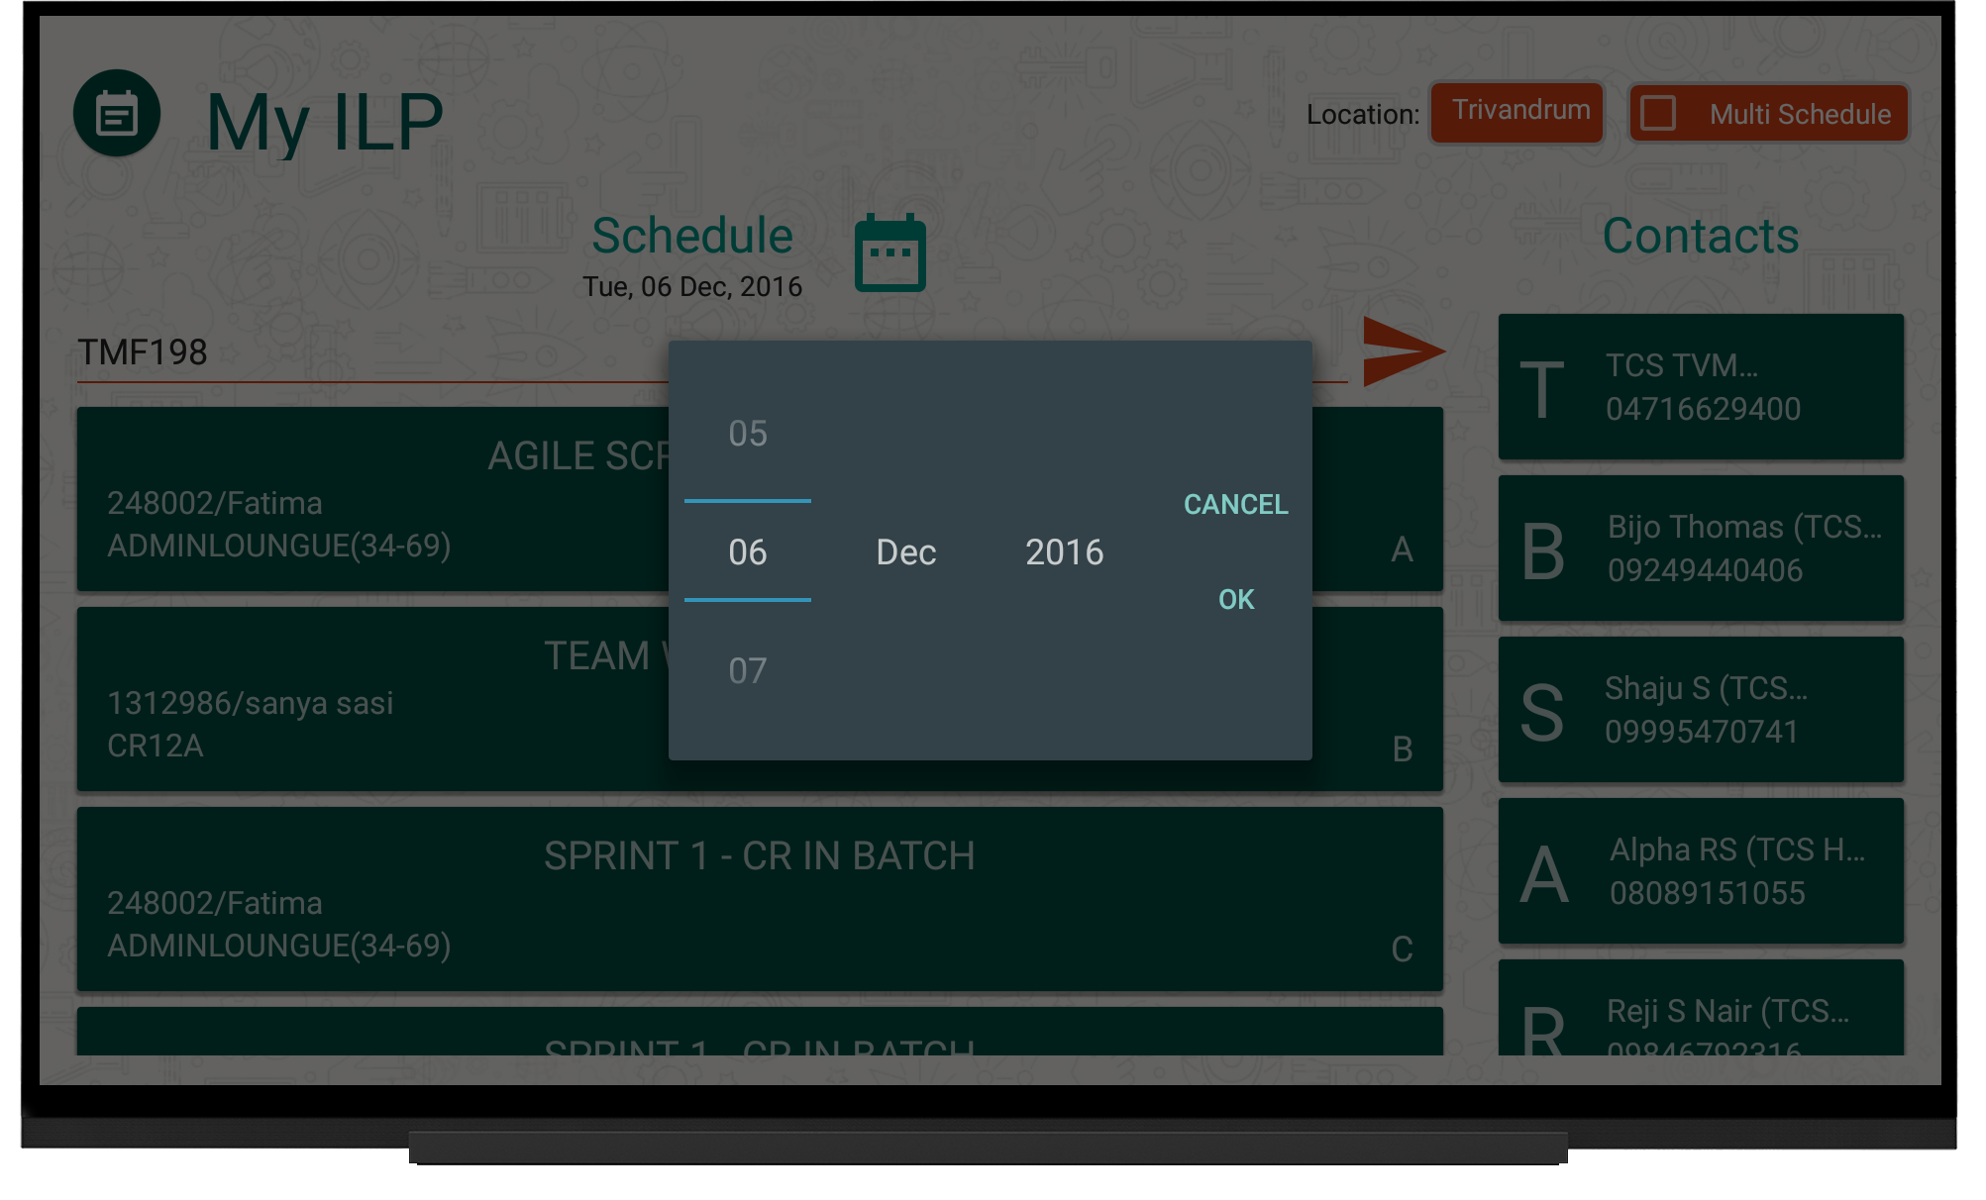
Home Screen

Slide 11
Multi-Schedule Screen
Display slot-wise schedule for all the LGs running at a particular location
Refreshes slots every 2 hours till 6 pm
Shows only next 3 slots at a time
Displays emergency contacts based on location selected in drop-down
UI toggle

Slide 12
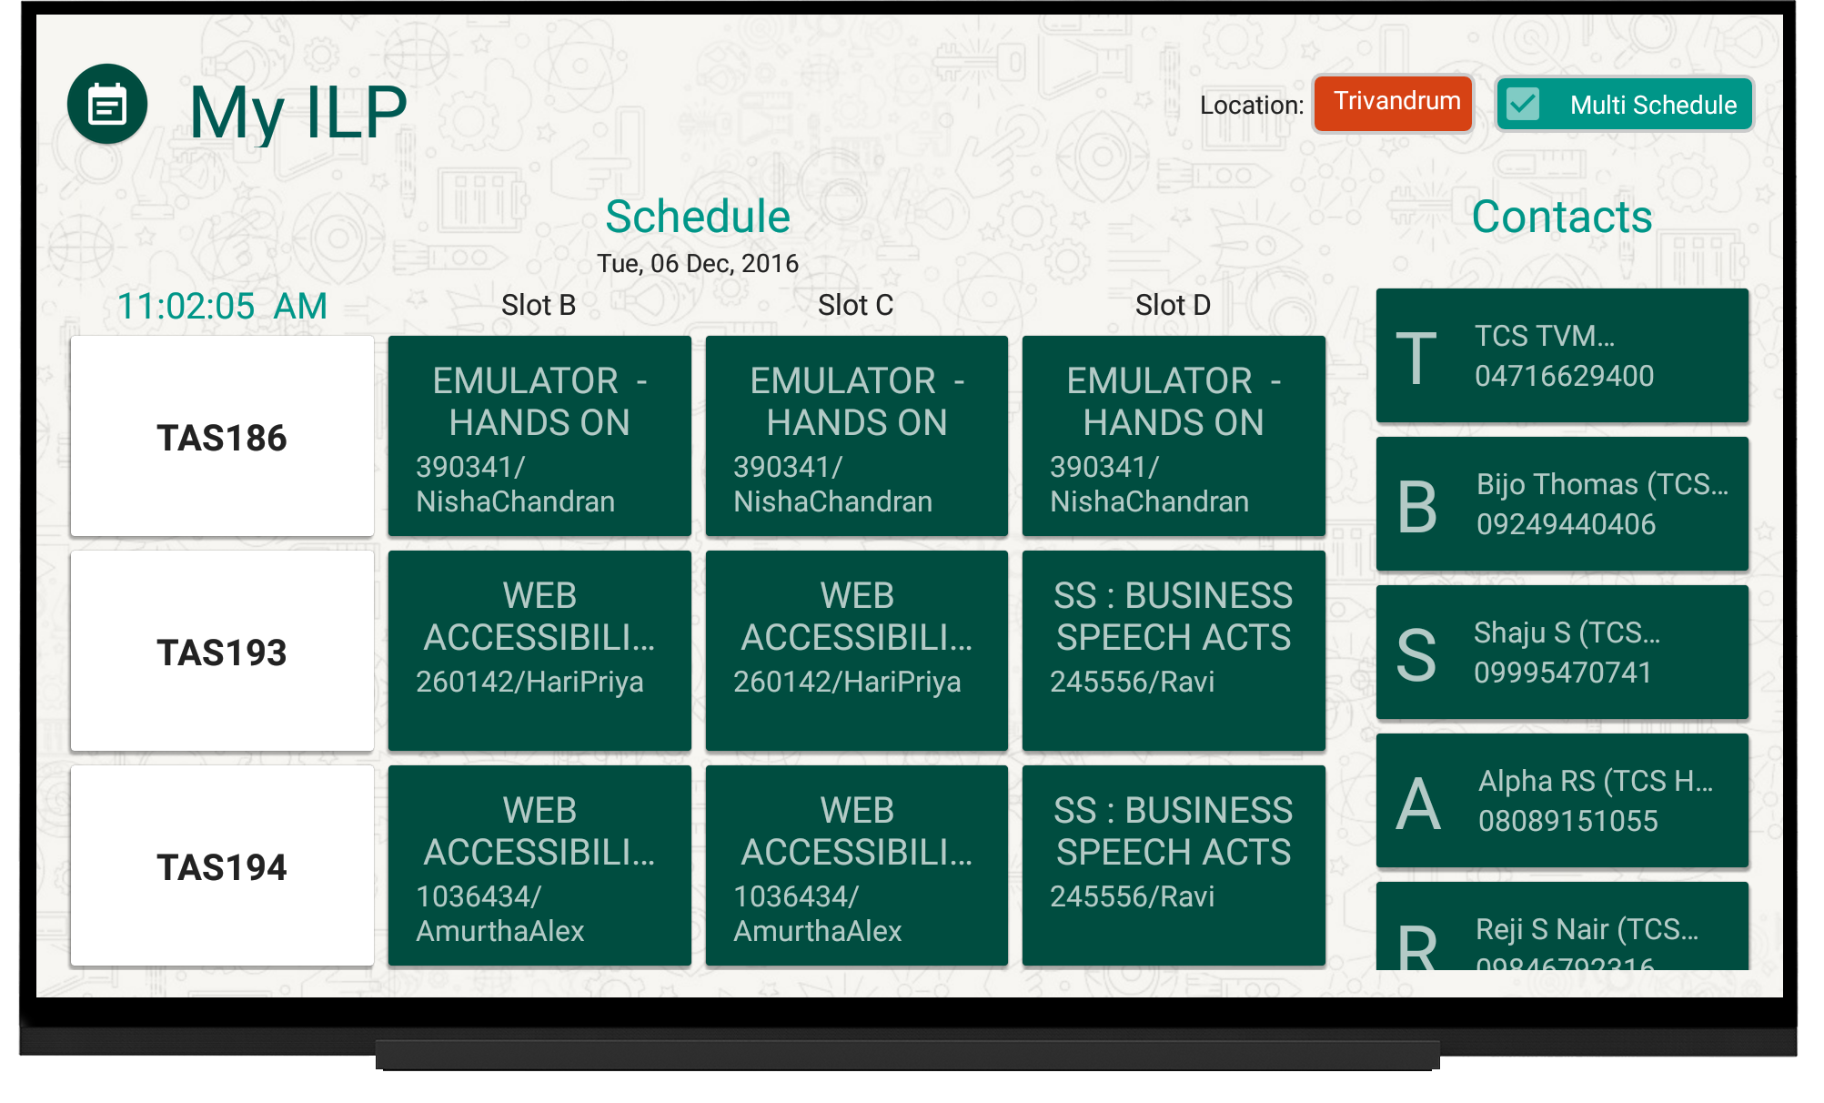
Multi-Schedule Screen

Slide 13
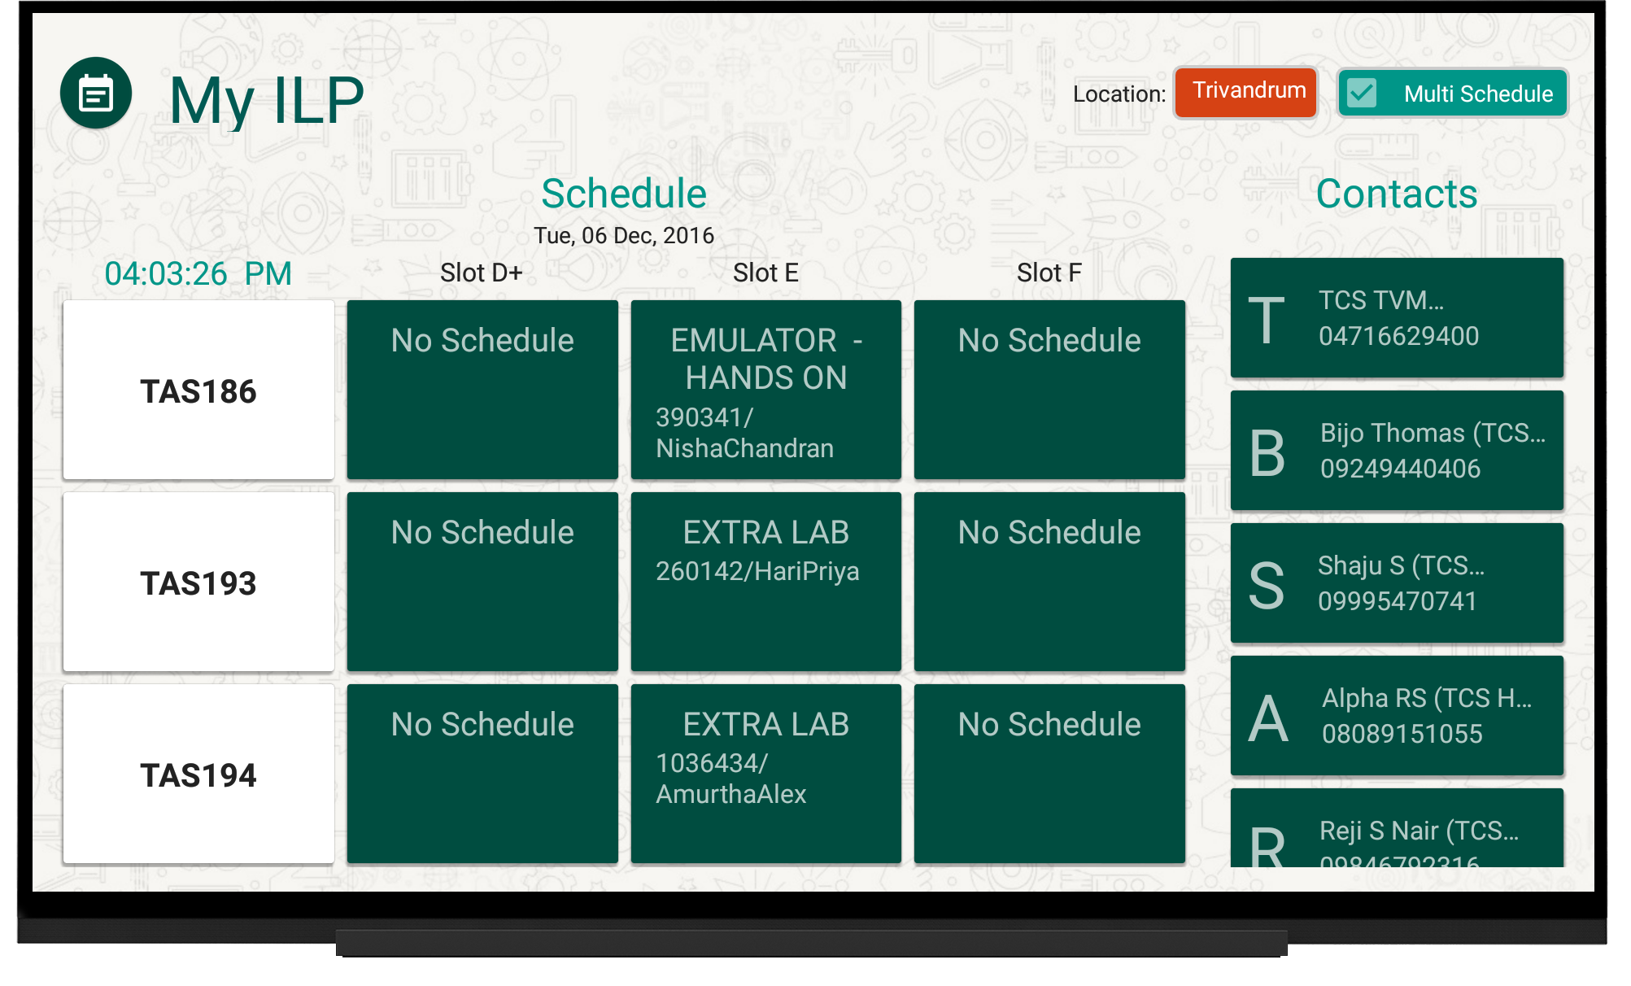
Multi-Schedule Screen

Slide 14
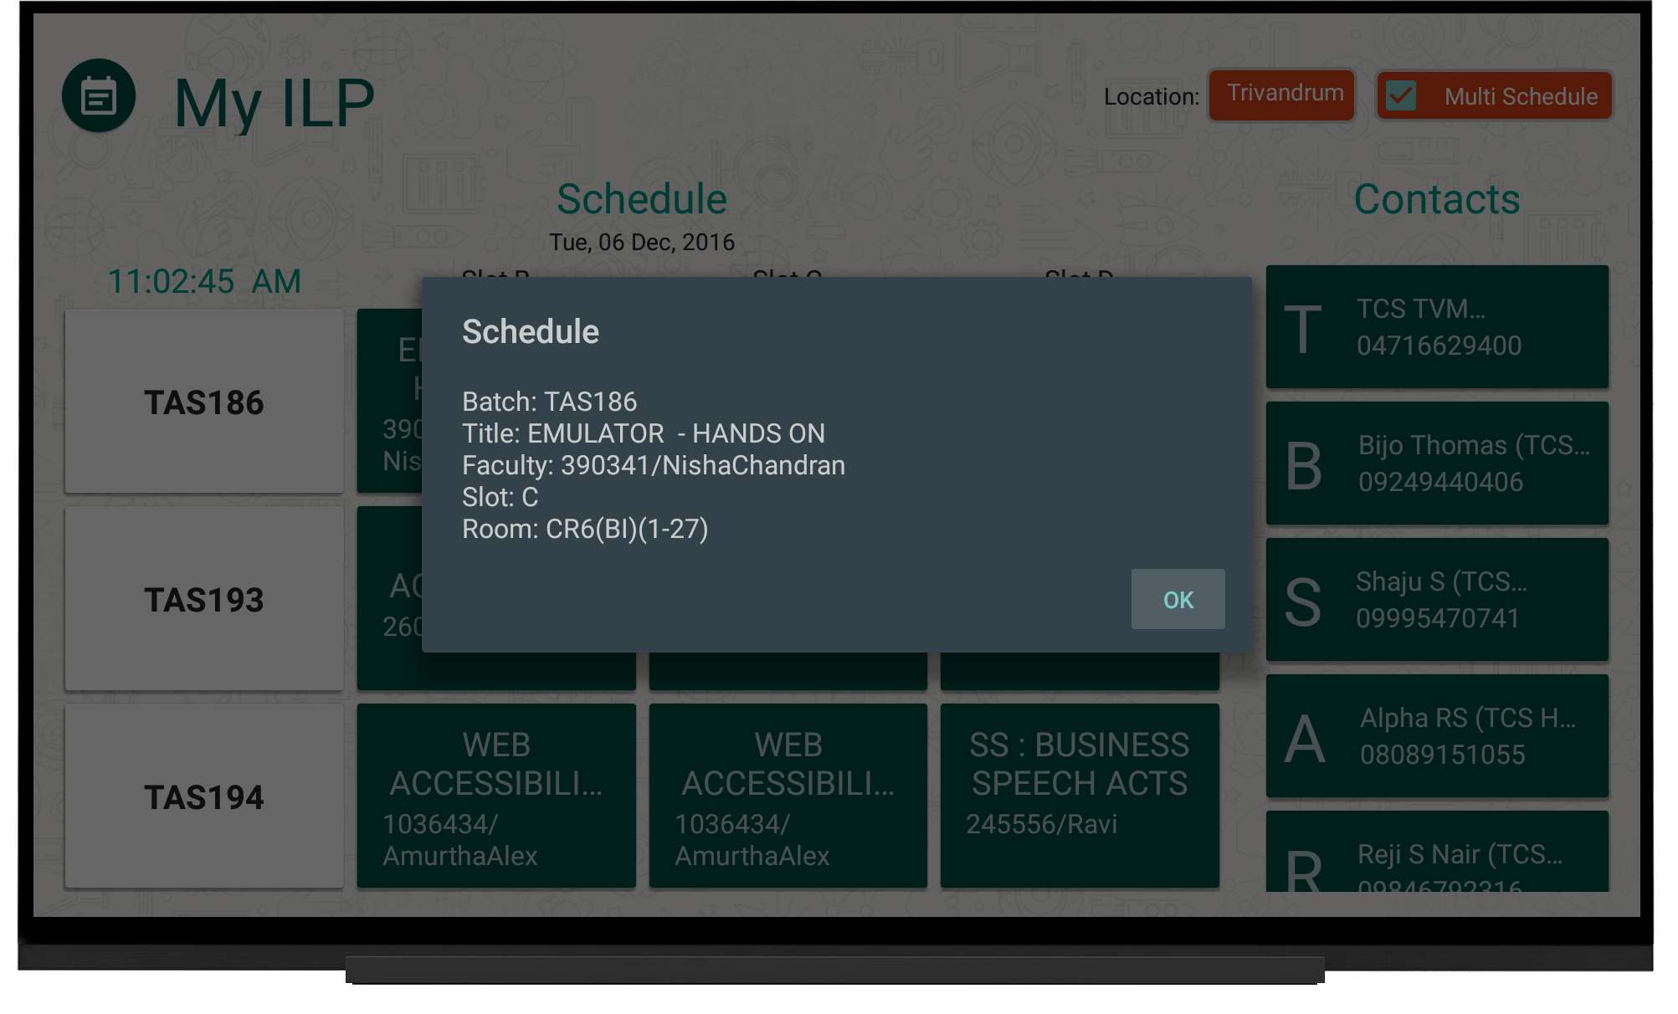
Multi-Schedule Screen

Slide 15
Issues & Challenges
Dynamic permission management from “Marshmallow (Version 24)” and above
Synchronizing with remote database and API
Restructuring and processing data on android device natively
  Custom algorithms
  Divide and Conquer algorithm
  Greedy algorithm

